Slide 1
X-Ray Test Management Tool

Slide 2

X-Ray Test Management tool
About Xray
Xray is a complete Test Management tool for Jira. It is a full-featured app that does not require any other software in order to run.
Xray supports the entire testing life cycle: test planning, test design, test execution and test reporting. We do this by using special Jira issue types, so you can use all Jira benefits that you are used to.
Features:
Create, organize, plan and execute your manual and automated tests
Manage all your tests, manual or automated, in the same way
Integrate seamlessly with Jira and Jira concepts
Track test progress in real-time
Create beautiful reports in docx, xlsx, pdf with Xporter
Enhance your Agile boards with requirement status and related executions
Import test definitions from Excel (CSV) for both manual and automated tests
Custom test and step statuses
Widely used by many organizations, including Fortune 500 companies
Always up-to-date with constant releases
Import automated tests and their results from automated test frameworks through TestNG, JUnit, NUnit, Robot and other runners
Ready to use : install and use it right away

Slide 3
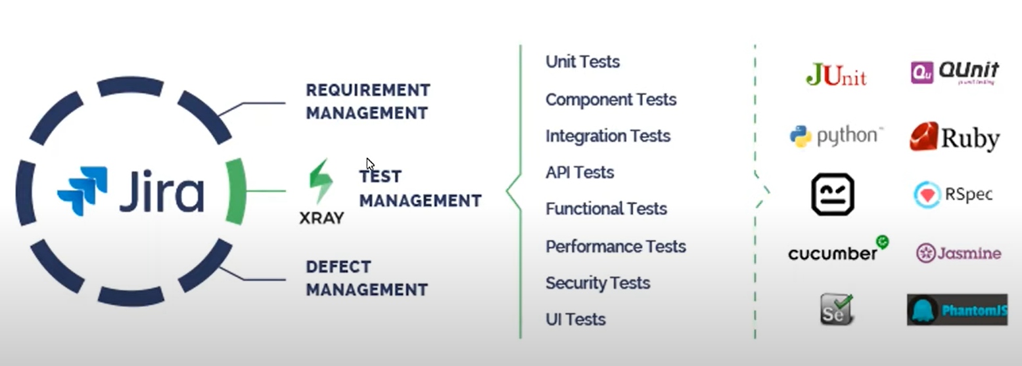




X-Ray Test Management tool

Slide 4
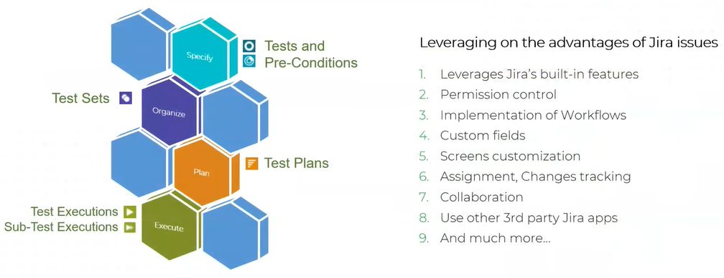
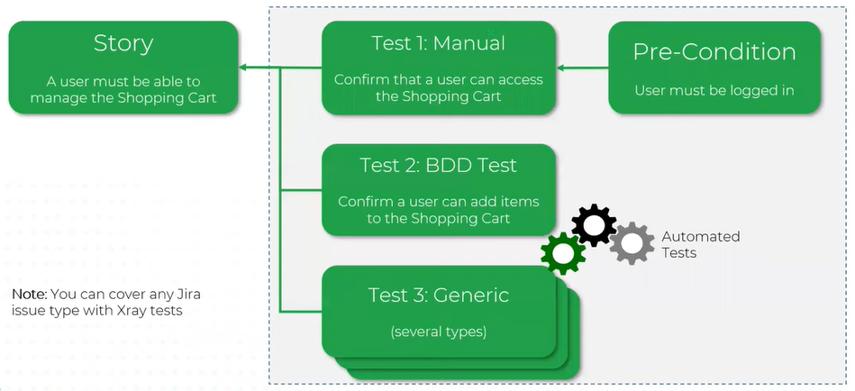
X-Ray Test Management tool

Slide 5
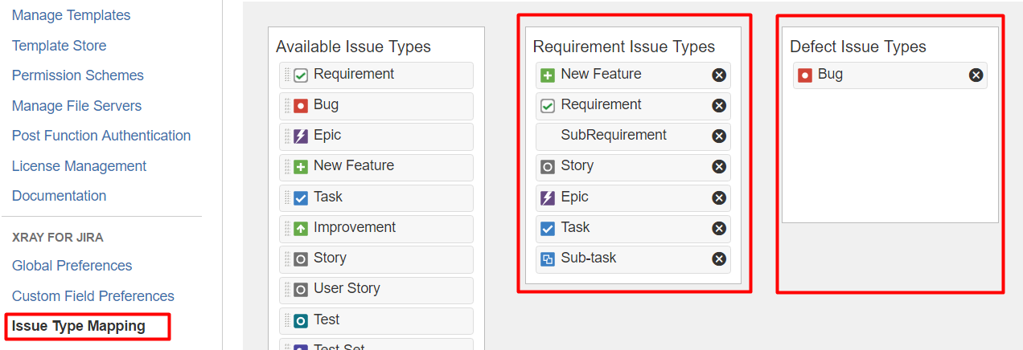
X-Ray Test Management tool
Configure Requirements and Defects
In Jira's administration, in the Add-ons tab, go to Issue Type Mapping and configure what issue types should be considered as "requirements" and "defects".
https://docs.getxray.app/display/XRAY/About+Xray

Slide 6
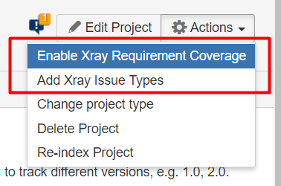
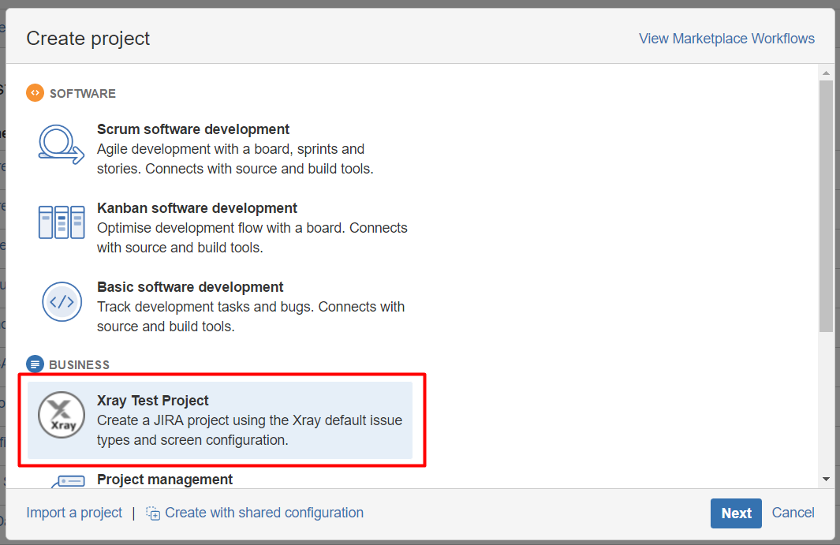
X-Ray Test Management tool
Enable Xray in your projects
You can enable Xray for your existing projects or create a new project with both standard and Xray issue types.
For existing projects, in the project Administration page, go to Actions at the top right-hand side. You can either:
a) set your project as a Requirements project by choosing "Enable Xray Requirement Coverage", so the requirements are covered by tests; or
b) add Xray issue types (i.e., Test, Test Set, Test Execution, Test Plan) to the project.
Create new projects from scratch with testing enabled:
If, instead, you want to quickly create a new project and use it to manage everything (e.g., requirements, defects, tests), go to the Jira Administration page for Projects. In the creation dialog, choose "Xray Test Project".

Slide 7
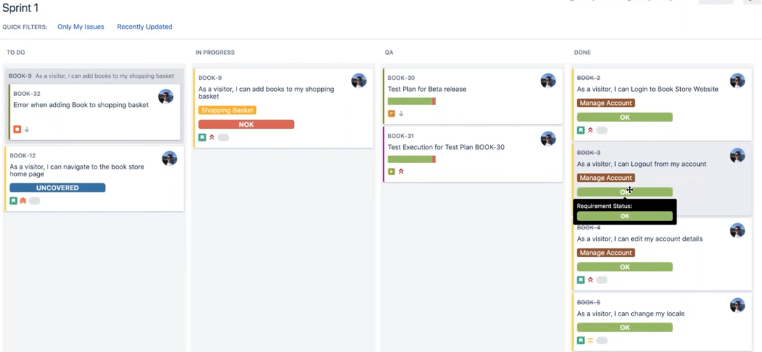
X-Ray Test Management tool

Slide 8
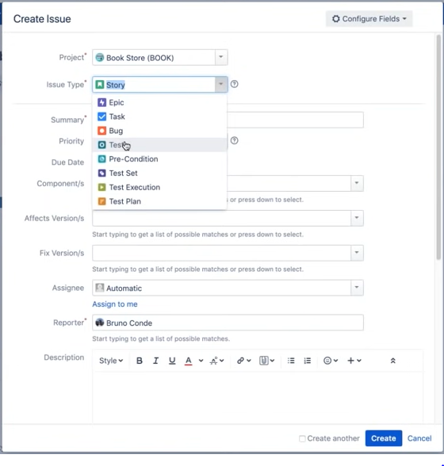
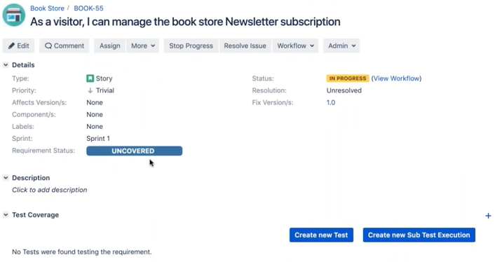
X-Ray Test Management tool
Writing Tests
Testing can be performed as individual components/units using Tests, or as a whole using Test Sets. The goal is to check and verify if a specific target requirement is applied, even when determined pre-conditions are set, and also help prevent and uncover situations and defects that could negatively impact the overall usability of the final product.

Slide 9
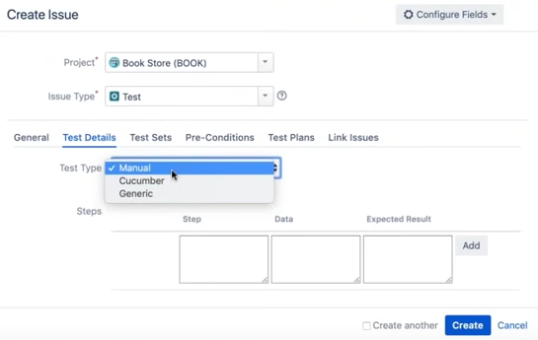
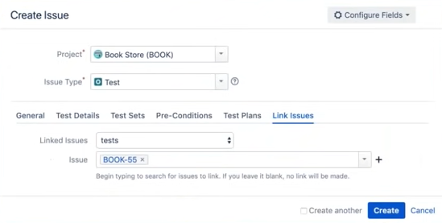
X-Ray Test Management tool
When you create test from the story it automatically fetch some data from story and links the test to the story

Slide 10
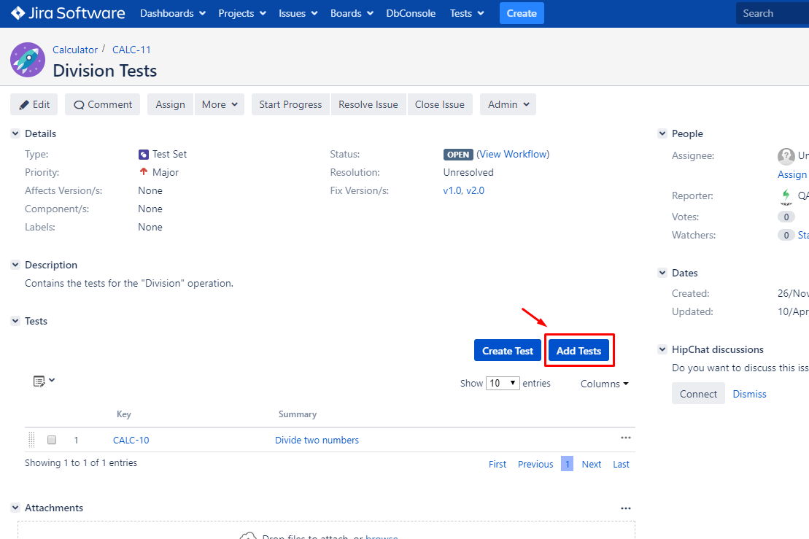
X-Ray Test Management tool
Organizing Tests
Xray provides two different but very effective ways of organizing Tests:
using Test Sets issues (this was the only available option before v3.0);
using the Test Repository (since v3.0);
From the Test Set issue view screen
To associate Tests with a Test Set from the Test Set issue view screen:
Step 1: Open the Test Set you wish to associate a Test with.
Step 2: Click the Add Tests button (under the Tests tab on the view page) to open the Issue Picker Dialog

Slide 11
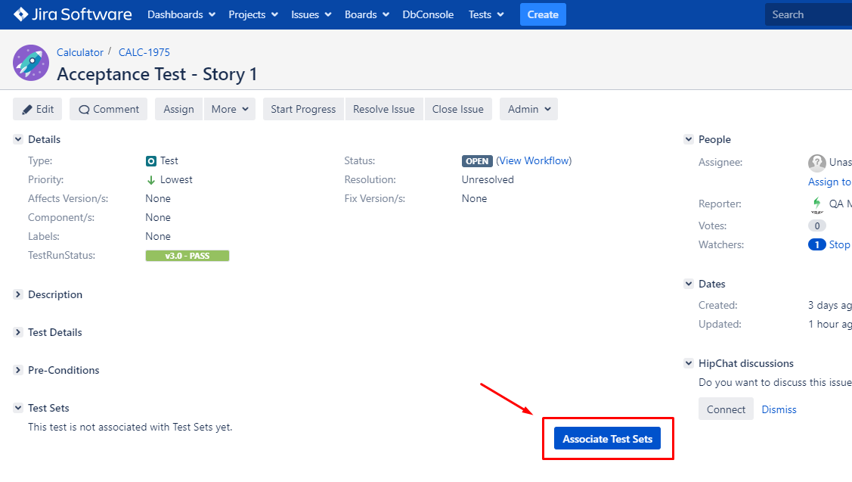
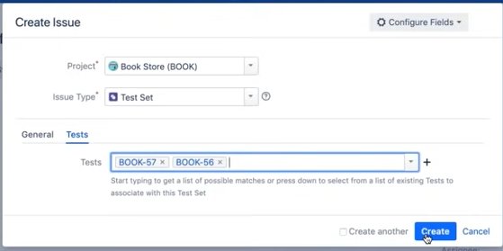
X-Ray Test Management tool
From the Test issue view screen
To associate Tests with a Test Set from the Test issue view screen:
Step 1: Open the Test you wish to associate a Test Set with.
Step 2: Click the Associate Test Sets button (under the Test Sets tab on the view page) to open the Issue Picker Dialog.

Slide 12
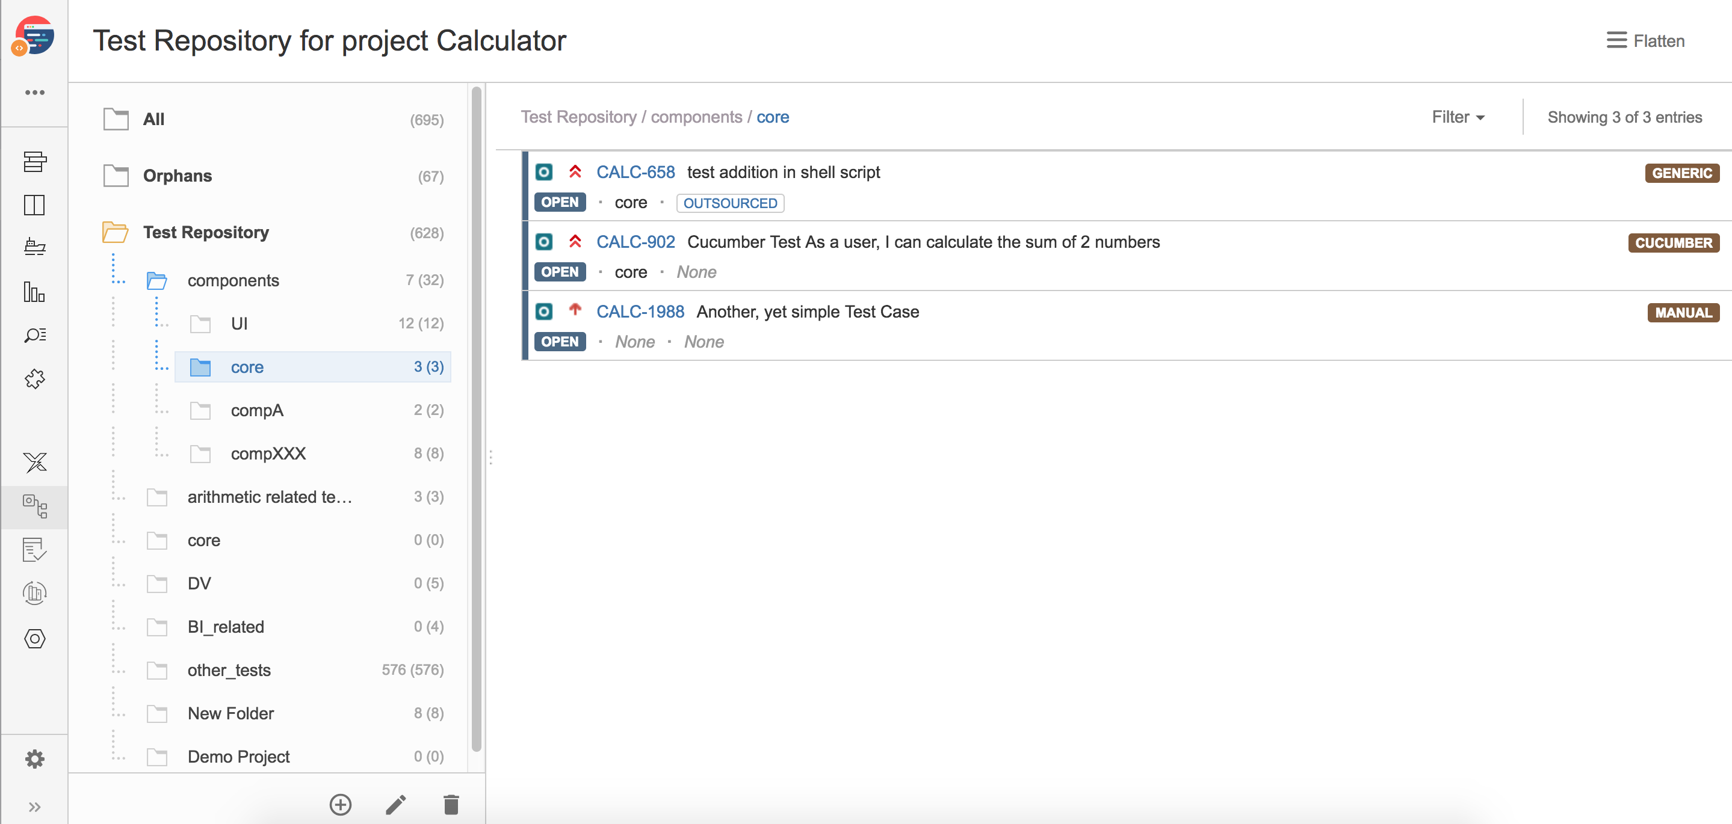
X-Ray Test Management tool
Test Repository
Xray v3.0 introduces the Test Repository concept which enables the hierarchical organization of Tests at the project level by allowing you to organize Tests in folders.

Slide 13
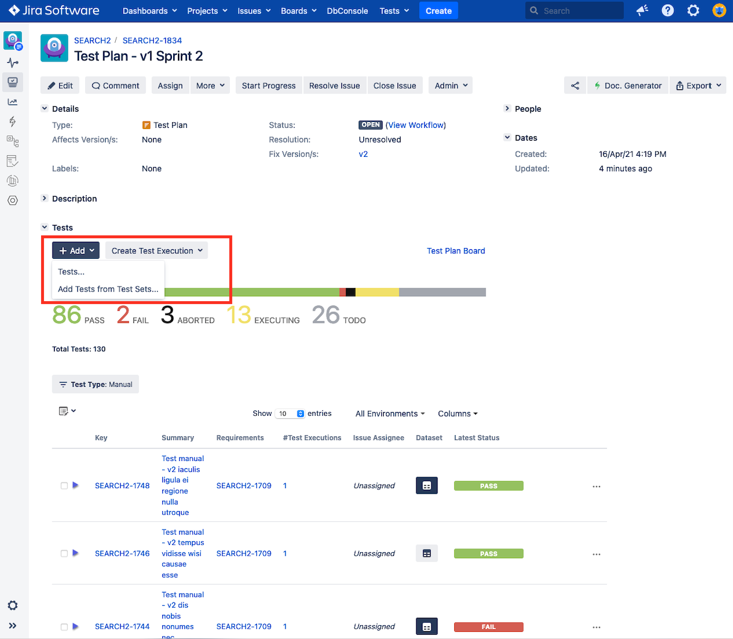
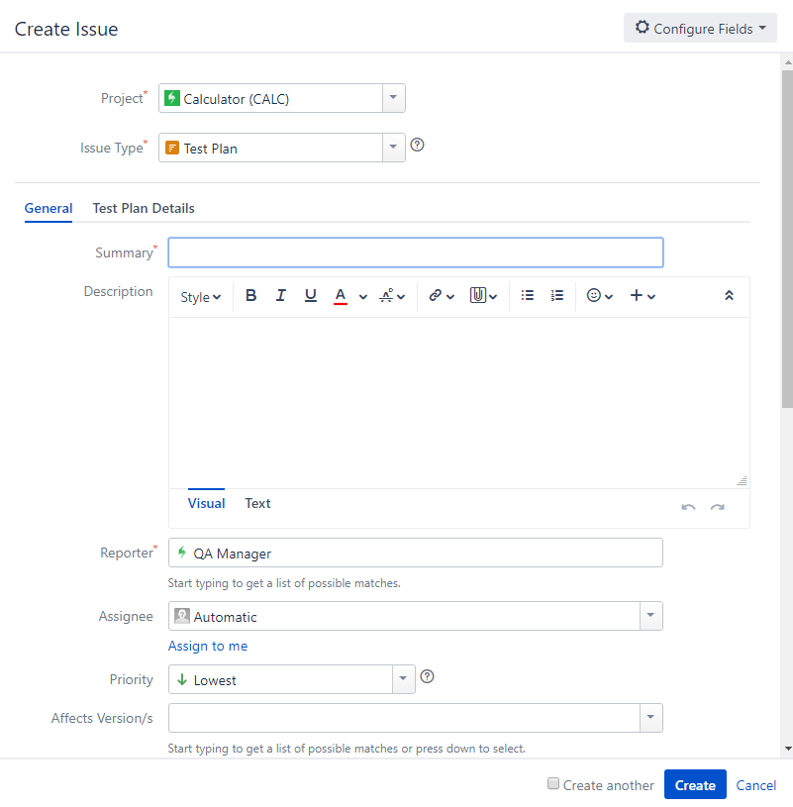
X-Ray Test Management tool
Planning Tests
Planning is the activity where you decide your testing strategy, e.g., which requirements you want to validate, how would you validate them, will it manual or automated, the resource allocation, and the execution plan (whom and when will execute the tests). Depending on several factors, you may want to prioritize some of the tests, or give more focus on some requirements.

Slide 14
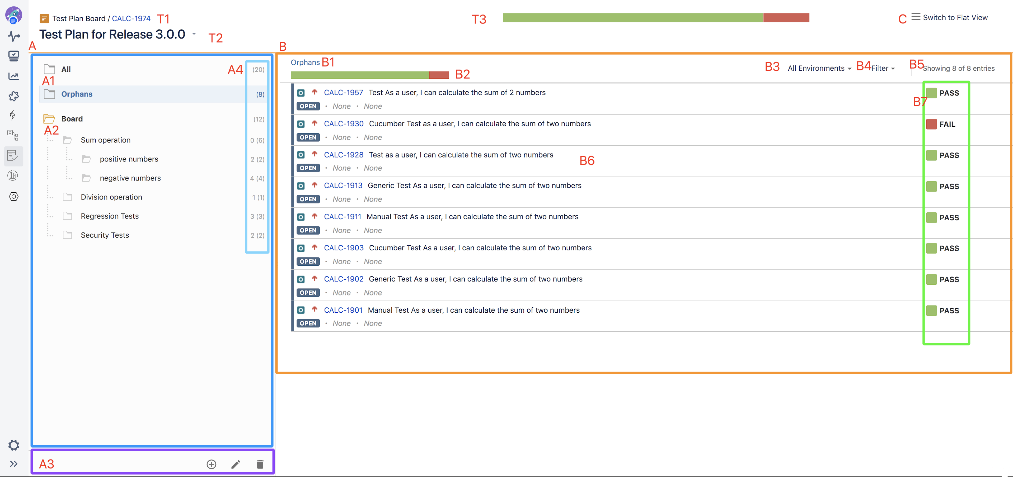
X-Ray Test Management tool
Test Plan Board
The Test Plan Board is a Test Plan-level test organization feature that allows you to organize Tests in a hierarchical way in folders. Always keep in mind that each Test Plan has an associated (Test Plan) Board and that a Test can only belong to one folder within the Board.

Slide 15
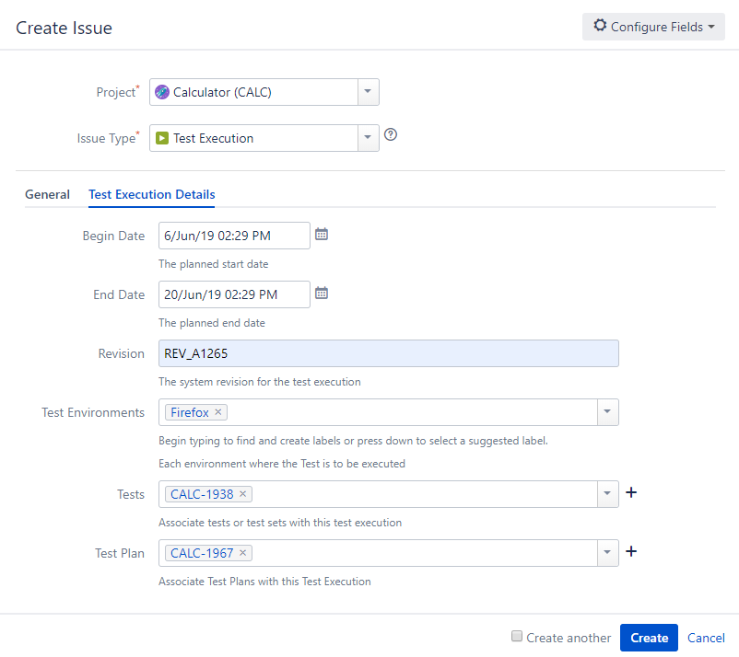
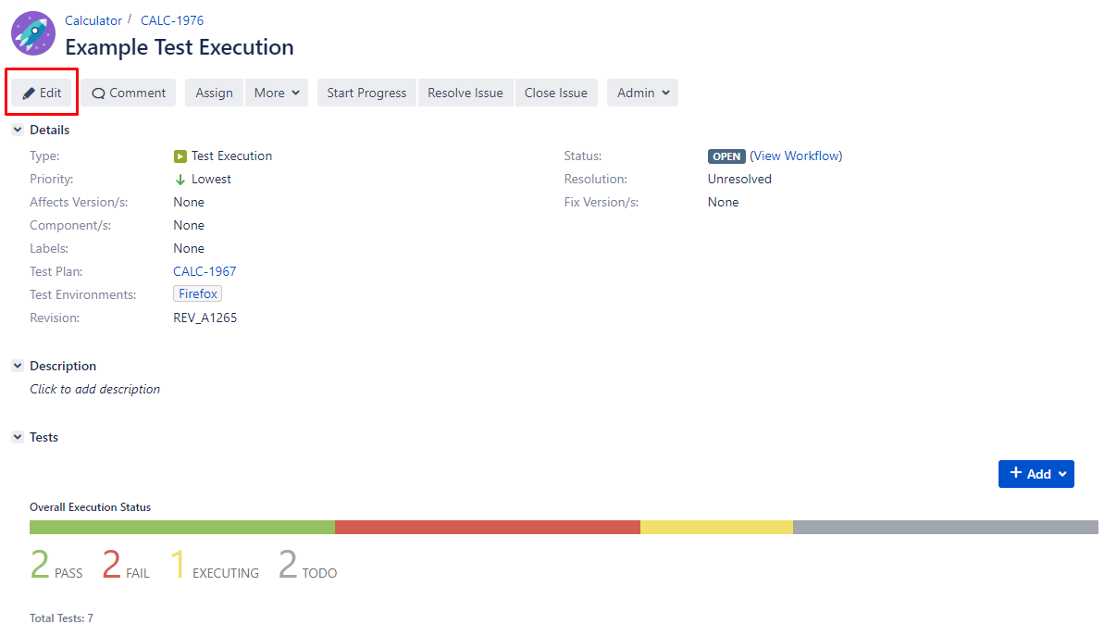
X-Ray Test Management tool
Executing Tests
Xray provides the Test Execution issue, which acts as an assignable task for executing a group of tests (either manual or automated) and collects the respective test results for a specific project version and environment.
A Sub-Test Execution is similar to a Test Execution, but created as a sub-task of a requirement.

Slide 16
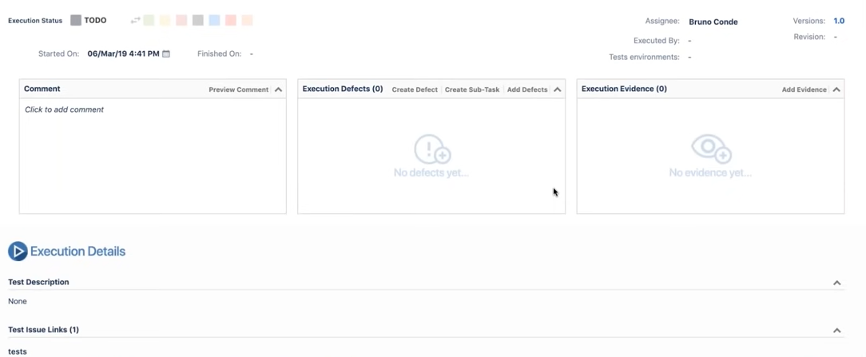
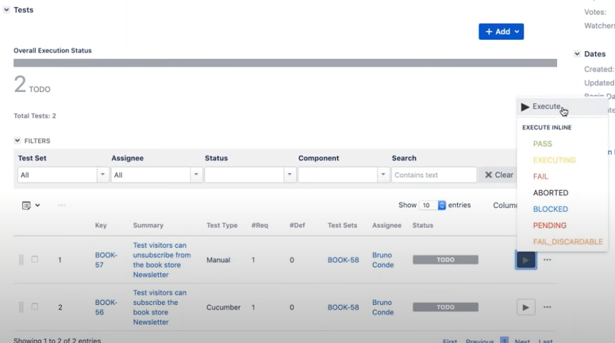
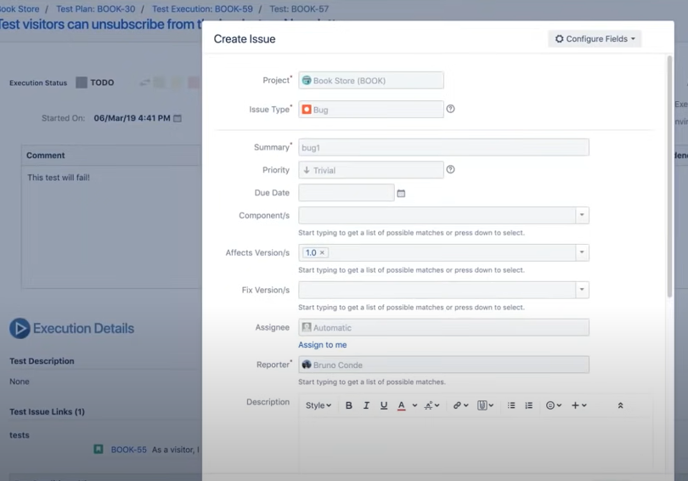
X-Ray Test Management tool
Executing Tests

Slide 17
X-Ray Test Management tool
Reports & Analysis
In order to obtain relevant metrics on the progress of your tests as well as the completeness of your requirements, Xray provides several ways that make it easier for the entire project team have a clear overview on "how ready" the project is.
As part of your daily tasks, you may use dedicated reports and gadgets in order to evaluate your testing progress.
Xray essentially uses Jira issues, so you can always use JQL to obtain relevant results. Since standard JQL may not be enough, Xray provides an extensive list of JQL functions that may be used to obtain relevant data.
using standard JQL queries
consulting the specific panels of Tests/Test Sets/Test Plans/Test Executions
using the Built-in Reports
building out dashboards using gadgets
using eazyBI's advanced reporting capabilities
using specific Xporter templates, if you want fully customized reports as a DOCX, XLSX or PDF assets.

Slide 18
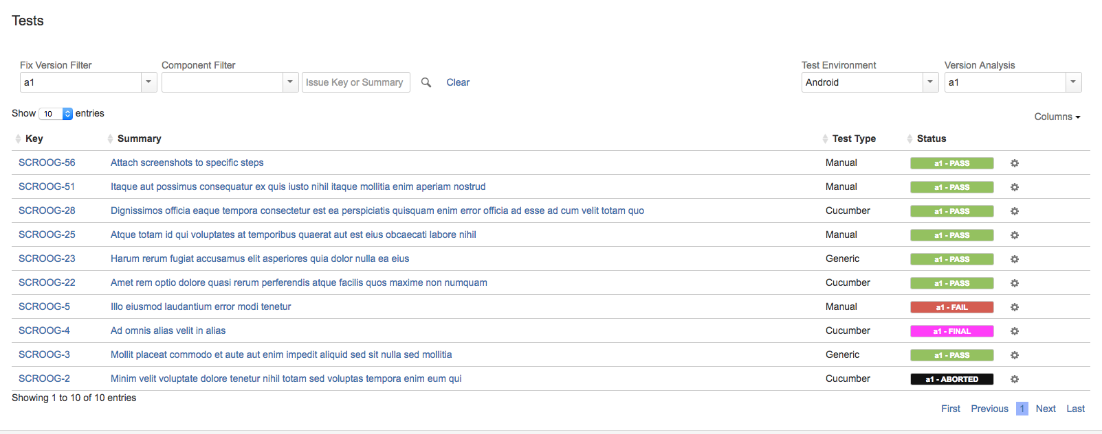
X-Ray Test Management tool
Track Testing Progress
Tests Overview
The Tests project tab shows a list of Test issues and their execution status. The status of a Test is calculated based on the latest Test Run of that Test, for a particular version and environment.

Slide 19
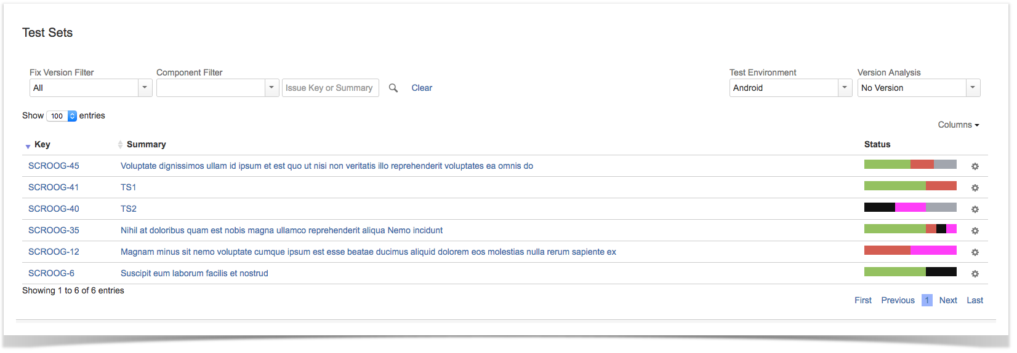
X-Ray Test Management tool
Test Sets Overview
The Test Sets project tab shows a list Test Sets issues and their corresponding execution status. A Test Set status is shown as a progress bar and is calculated based on the version specified in the Version Analysis field, and the environment specified in the Test Environment field. This allows a transversal analysis of the Tests Sets for a project in a particular version and environment.
The status of a Test Set is calculated based on each latest Test Run Status contained in the Test Set

Slide 20
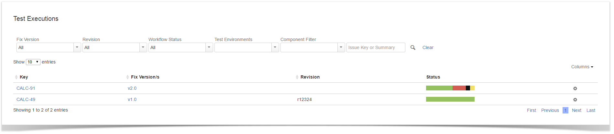
X-Ray Test Management tool
Test Executions Overview
The Test Executions project tab shows a list Test Execution issues and their corresponding execution status. A Test Execution status is shown as a progress bar with the latest Test Run status from each Test issue that is associated with that Test Execution. This list allows a transversal analysis of the Tests Executions for a project.

Slide 21
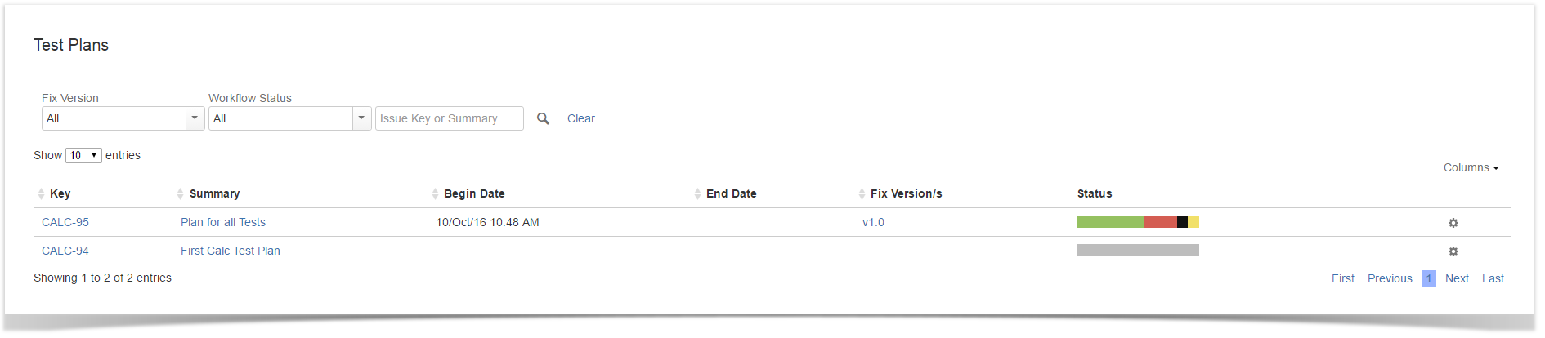
X-Ray Test Management tool
Test Plans Overview
The Test Plan project tab shows a list of Test Plan issues and their corresponding execution status. The Test Plan status is shown as a progress bar with the latest Test Run status from each Test issue that is associated with that Test Plan. This list allows a transversal analysis of the Tests Plans for a project.

Slide 22
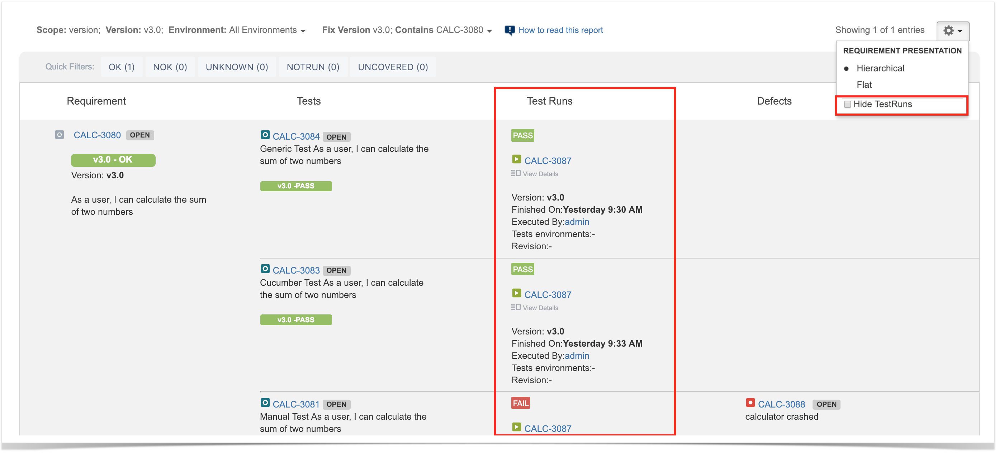
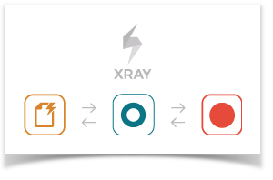
X-Ray Test Management tool
Traceability Report
Shows the requirements traceability through tests, test runs and defects

Slide 23
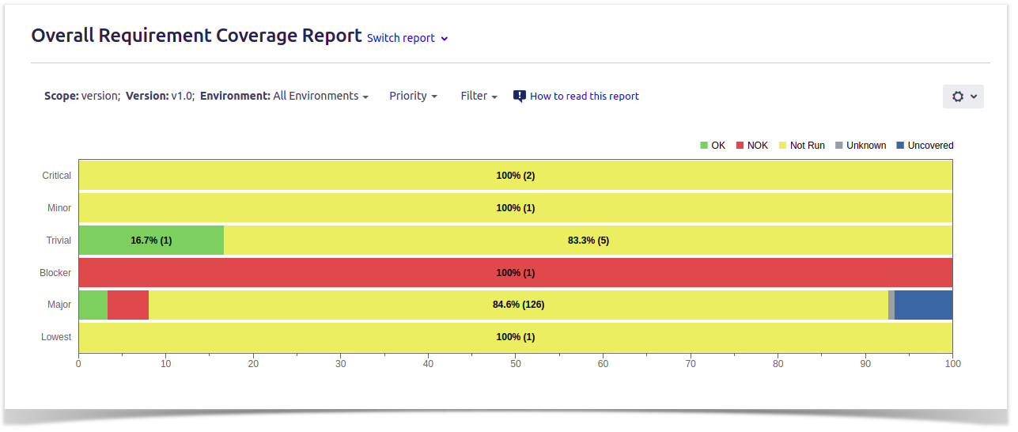

X-Ray Test Management tool
Overall Requirement Coverage Report
Shows a normalized horizontal stacked bar chart with the current Requirements coverage for the selected Analysis Version (or Test Plan), Test Environment and Grouping field.
Each bar on the chart represents a group of Requirements with a different value provided by the grouping field. Stacked within each bar are the Requirements grouped by coverage status: OK, NOK, NOT RUN, UNKNOWN and UNCOVERED.

Slide 24
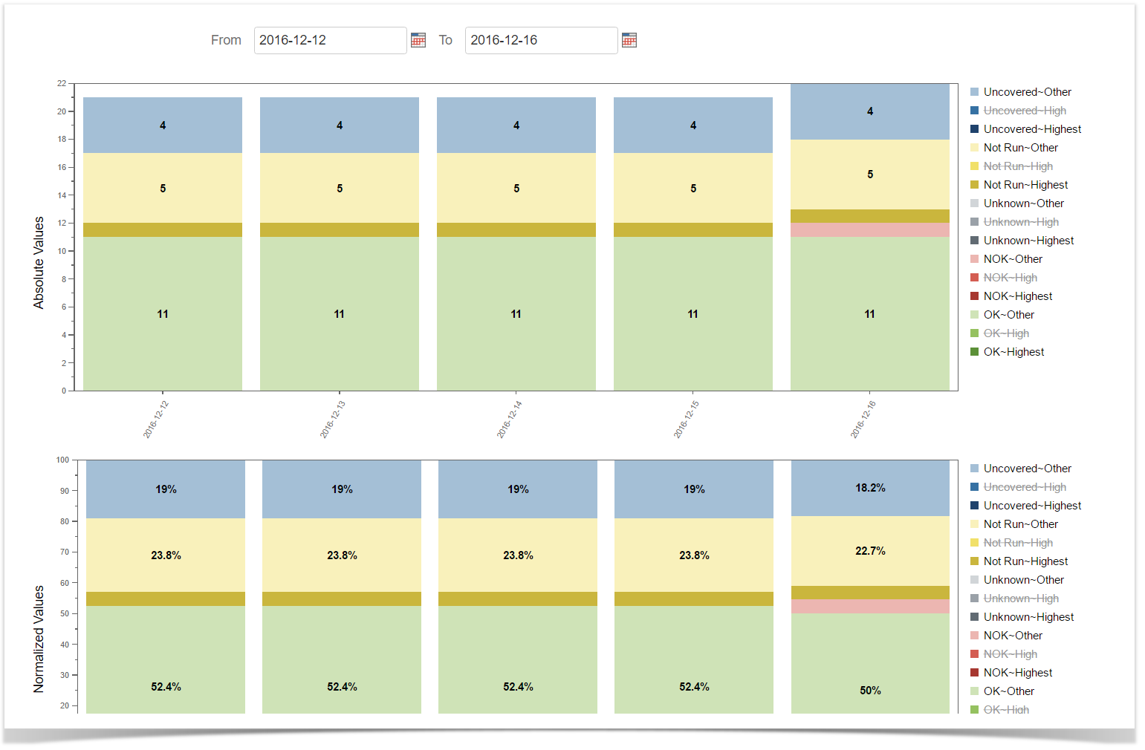

X-Ray Test Management tool
Historical Requirement Coverage Report
Shows a daily historical view of Requirements coverage. It is possible to see the evolution of the Requirement's coverage status over time for a particular Analysis Version (or Test Plan) and Test Environment.
This report is either accessible from Xray Reports icon on the project left sidebar or from the standard Reports icon, which includes other kinds of reports besides Xray.
At the top of the report you'll find several areas related with the report and with the data shown in the report.
A: Analysis & Scope, for choosing how to analyze the entities
B: Group by, for defining how to visually group/aggregate items
C: Filter, for selecting the source data
D: Data range
E: Visualization information and options

Slide 25
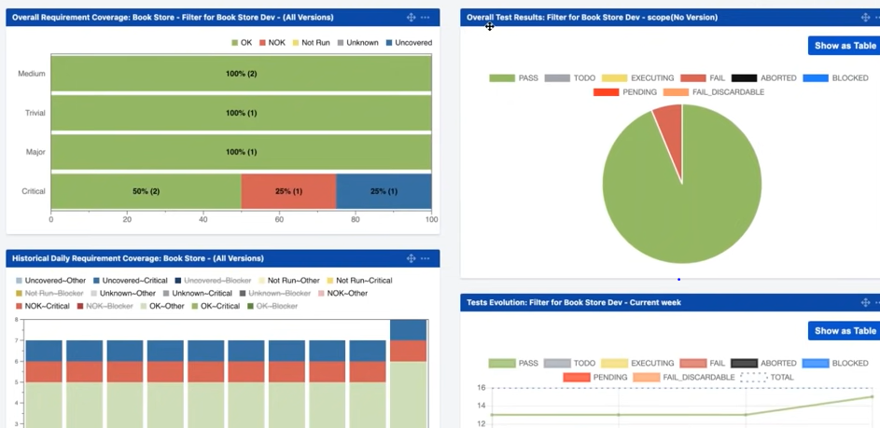
X-Ray Test Management tool
JIRA Dashboard with X-Ray Gadgets

